Slide 1

Gesture control RC robot
Presented By : The Assembly Team

Slide 2
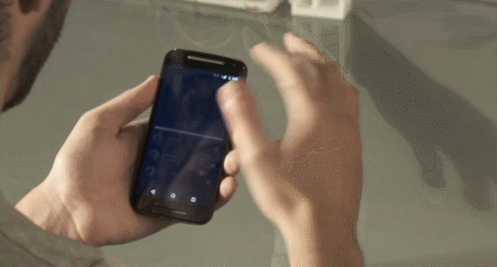
Why make it?
Gesture control can improve the quality of native navigation by automating applications for home users, the need for an input device can be replaced using the right kind of gesture control device.
Applications :
Assembling the RC robot
Navigating the robot using gestures
OpenCV and Visual studios
Notes:
*explain gesture control

Slide 3
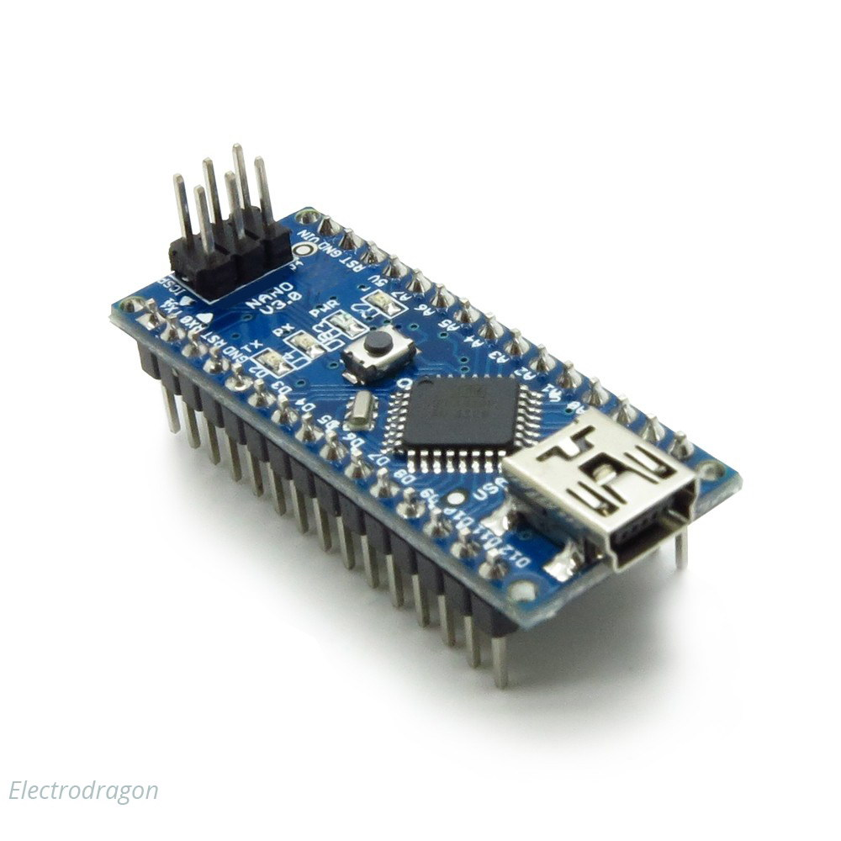
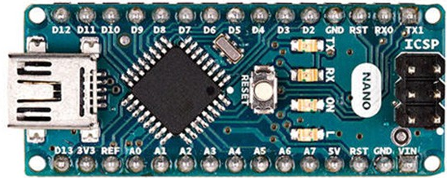
Arduino NANO
Notes:
The Arduino Nano is a small, complete, and breadboard-friendly board based microcontroller
Nano has two extra analog pins
Good replacement for uno as it is breadboard friendly

Slide 4
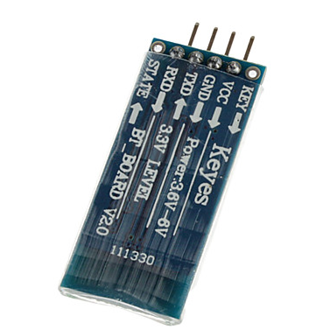
HC062 (Bluetooth module)
Notes:
*The HC-06 acts as a serial port through which you can send and receive data.
*So using a serial terminal or a Bluetooth customized application on your computer or phone, you can control and monitor your project.
*HC06 functions only as slave to a microcontroller

Slide 5
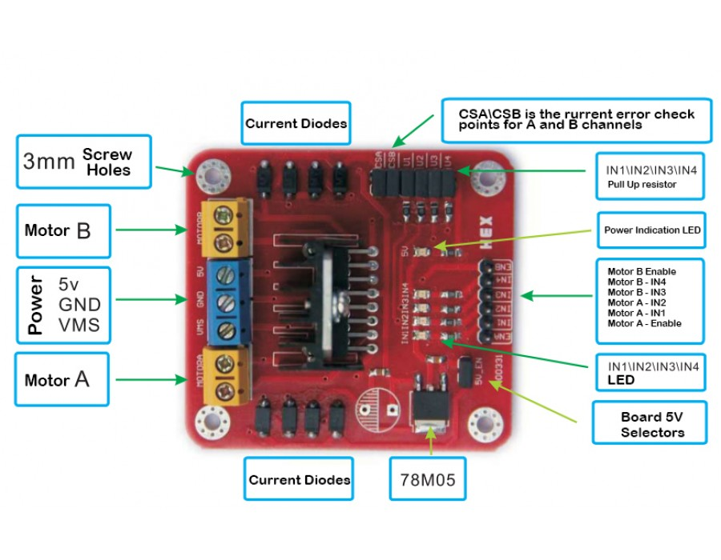
L298N (motor drive)
Notes:
*L298N Dual H-Bridge Motor Controller module
*H-Bridge's are typically used in controlling motors speed and direction, but can be used for other projects such as driving the brightness of certain lighting projects such as high powered LED arrays.
*An H-Bridge is a circuit that can drive a current in either polarity and be controlled by *Pulse Width Modulation (PWM)
*Pulse Width Modulation is a means in controlling the duration of an electronic pulse
*Motors are rated at certain voltages and can be damaged if the voltage is applied to heavily or if it is dropped quickly to slow the motor down.
* The longer the pulses the faster the wheel will turn, the shorter the pulses, the slower the water wheel will turn.
*why a motor driver

Slide 6
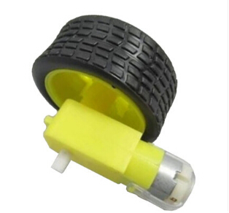
Geared DC motor
Notes:
*A gear motor is a specific type of electrical motor that is designed to produce high torque while maintaining a low horsepower, or low speed, motor output.
*They do so Gear motors are primarily used to reduce speed in a series of gears, which in turn creates more torque.
*used in devices such as can openers, garage door openers, washing machine time control knobs and even electric alarm clocks.
*difference between normal motors and geared

Slide 7
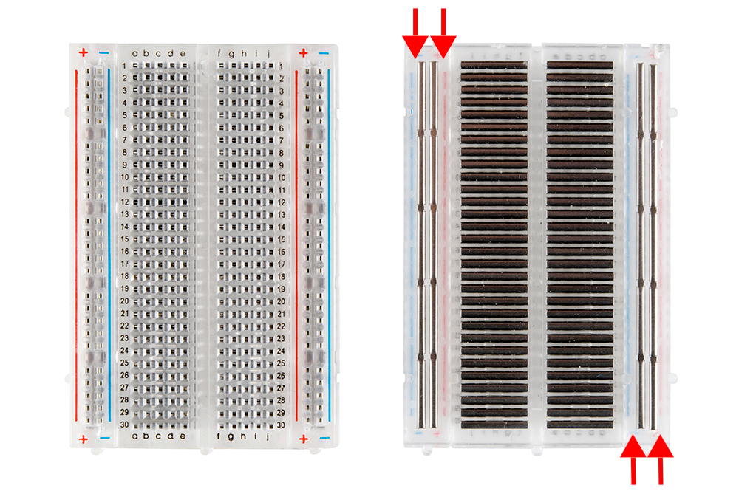
BreadBoard

Slide 8
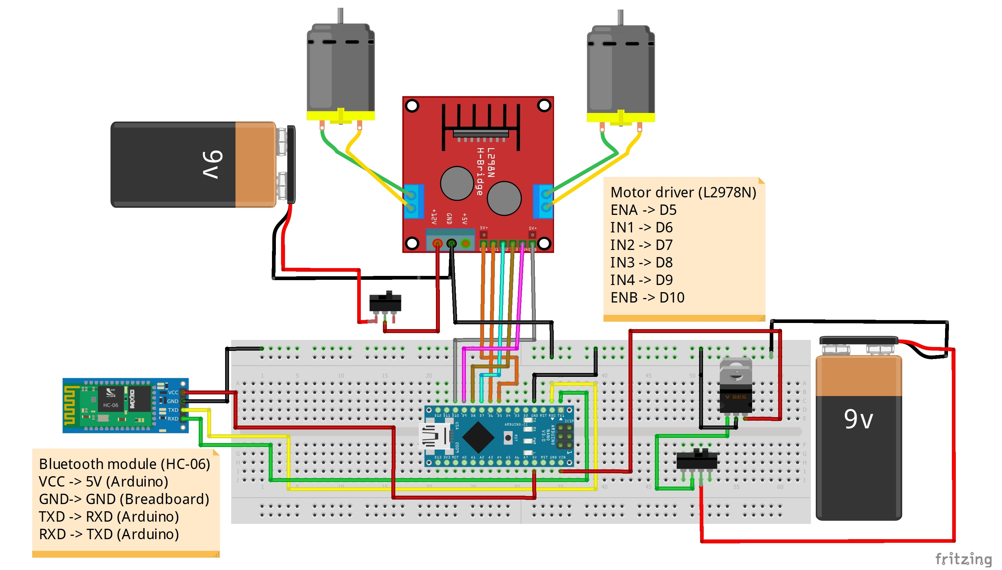

Slide 9
Software
Download the Arduino IDE (https://www.arduino.cc/en/Main/Donate)
If needed, download the Visual Studio 2015 IDE (https://www.visualstudio.com/vs/older-downloads/)
Download the opencv (https://sourceforge.net/projects/opencvlibrary/files/opencv-win/3.1.0/)
Use this github link to access all necessary codes and schematics (https://github.com/TheAssembly/Gestures_RC)

Slide 10
Configuration steps
In C:\, make a new folder and call it “OpenCV-3.1.0”.
Open the OpenCV.exe file downloaded, and under extract, enter the following file location: C:\OpenCV-3.1.0 and click extract
Open control panel > System and Security > System > Advanced system settings and select environment variables.
Under System variables, find “Path” and select it and click edit. Next to variable value, insert the path C:\OpenCV-3.1.0\opencv\build\x64\vc14\bin and click ok and exit.

Slide 11
Visual studio libraries settings
Open visual studio 2015 and go to file > new > project > visual c++ > empty project and name it “source.cpp”. Also, uncheck the boxes “create directory for solution” and “add to source control”, then click ok.
Once done, in the solution explorer, right click and select “add item”. Select c++ file and enter the name SerialClass.cpp and press okay. Repeat this step for tserial.cpp.
Similarly, for tserial.h and SerialClass.h, select add item and header file for both of them.
Open the github link and select source.cpp and click raw and copy the code and paste it in the source.cpp just created on Visual Studio. Repeat steps for SerialClass.cpp, SerialClass.h, tserial.h and tserial.cpp.
Finally, on the top toolbar, change from x86 to x64.

Slide 12
OpenCV libraries settings
Go to Project > Configuration properties >VC++ directories > include directories and click edit. Add the following path C:\OpenCV-3.2.0\opencv\build\include and press ok.
In the same window, select library directory and edit and add the path C:\OpenCV-3.2.0\opencv\build\x64\vc14\lib and press ok.
In the same window, under linker, select input > add dependancies and edit and add the name opencv_world320d.lib and click ok. Then click apply and finally click ok.

Slide 13
Setting up the Bluetooth connection
Open the Bluetooth on laptop and pair it with HC-06. for HC06, the password is either “0000” or “1234”
Once paired, check which COM value is outgoing ie. Which COM value is associated with HC-06 ‘DevB’
Make sure this value is written on top of the visual studio code where COM connection is established to ensure communication between the laptop and Arduino.

Slide 14
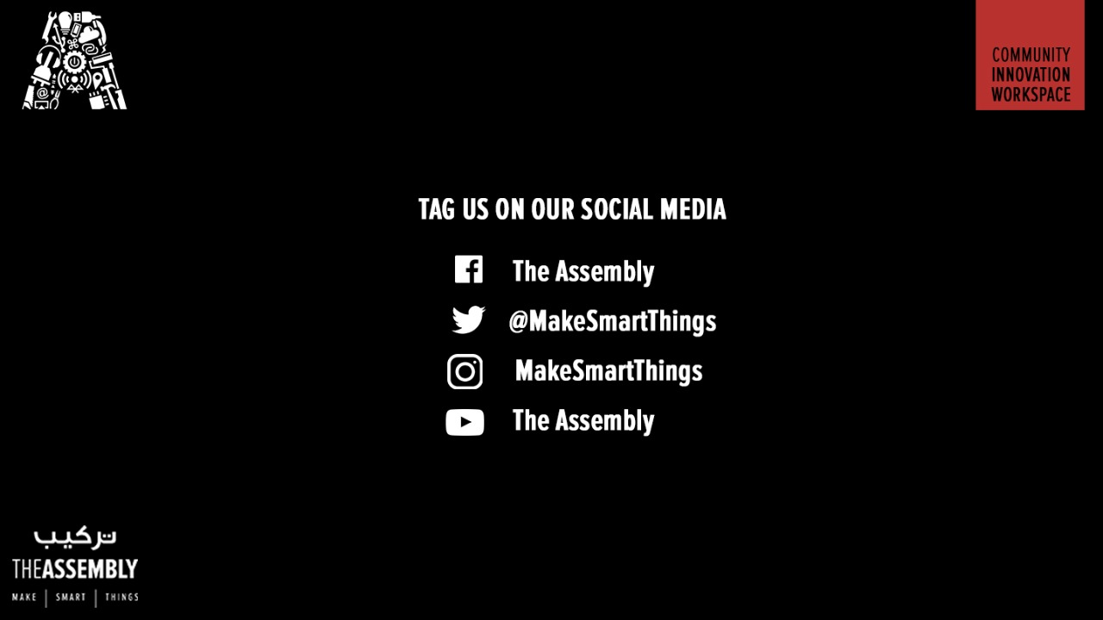
THANK YOU

